Slide 1


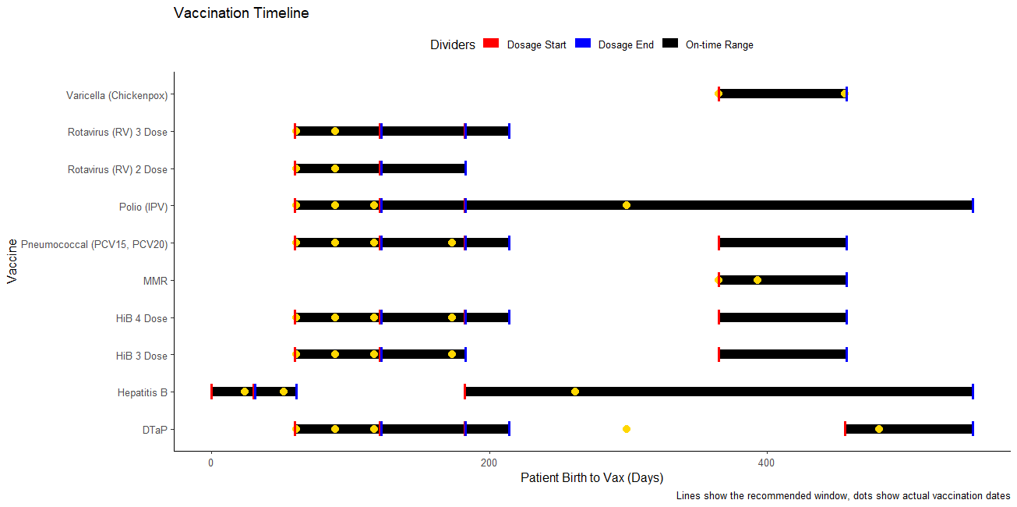
GDPH Childhood Vaccination
Aidan Estes
APE Student Work Showcase
Intro/Motivation
Process
Results so far
What is the process for answering the central research question you have been helping to explore?
Create an R program to find estimated vaccine coverage in routine childhood vaccines
Input childhood vaccination event data from Georgia Department of Public Health (GDPH) into the program to further understanding of certain vaccination rates
What is the central research problem or question you have been helping to explore?
What work has been done previously in this area?
This section can be a review of the literature that has been most important in your research area
What we have:
2 R functions and .rmd file to test current and new vaccines based on CDC recommendations
Able to update in future by pulling data directly from CDC website using ETL
Pseudocode document with details on what each line of code does and how to recreate
Ability to sort data and determine what vaccines should be expected to have received based on end-of-month birthdates
Code is commented on and can be modified
Created a standardized Excel format to include dose spacing and vaccine scheduling for all recommended CDC vaccines
Organized all in GitHub repository in the CIDMATH organization
Starting out:
Created artificial vaccine events to test code
Learned how to document and write pseudocode
Created a GitHub account and synced data with GitHub Desktop
Learned organization and file structures for GitHub projects
First Issues:
Developed a function for a driver table and vaccine schedule to show what vaccines were received for each patient ID and what vaccines should have been received
Calculation relied on personally identifiable information like birth date and vaccination date
This was not available as Georgia laws prevent receiving this information
First Solutions
Moving past this through various work arounds with the Lubridate R package.
Set every birthday to end of month to allow a larger window for evaluating on-time status
Skills Learned / Methods Practiced
In order to code the program and collaborate, skills were honed in:
GitHub and GitHub Desktop
Excel
RStudio and R
Development of new functions
SAS
Creation of test datasets
Basis of ETL (Extract, transform, load) with CVX codes URL
Reviewing previous literature, CDC websites and documentation, and the NIS surveys and their code also helped further my APE experience.

